Slide 1
Acid- Metal Reactions

Slide 2
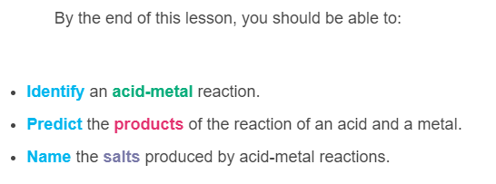
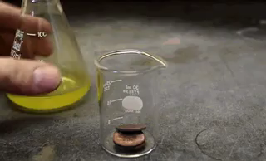

Slide 3
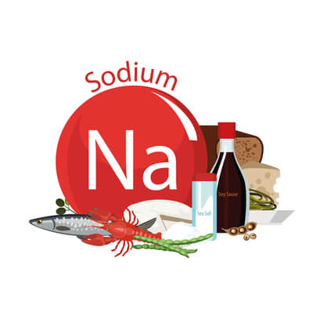
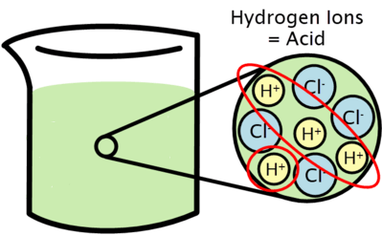
The reactants of an acid-metal reaction are, unsurprisingly, an acid and a metal.
An acid is a substance that releases hydrogen ions when it dissolves. Examples include hydrochloric acid (HCl), sulfuric acid (H₂​SO₄​) and nitric acid (HNO₃​).
Metals are elemental substances, such as iron (Fe), aluminium (Al) and sodium (Na).

Slide 4

An acid will react with a metal, creating two products.
The products are a salt, and hydrogen gas.
We can write the word equation as:
Acid + Metal → Salt + Hydrogen

Slide 5
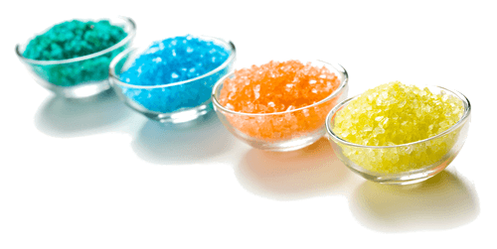
Much like "Acid" or "Metal", "Salt" is the name of a type of chemical.
When people say salt, they usually mean sodium chloride (table salt), but this is just one example of a salt.
A salt is an ionic compound made up of a metal ion and a non-metal ion. Examples of salts include potassium chloride, calcium chloride, and copper sulfate.

Slide 6
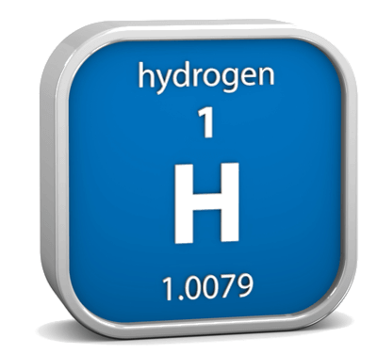
Acid-metal reactions always produce hydrogen gas.
It can be written as "hydrogen gas", "hydrogen", or as the chemical symbol H₂​.
This product does not change, regardless of the types of acids and metals used in the reaction.

Slide 7
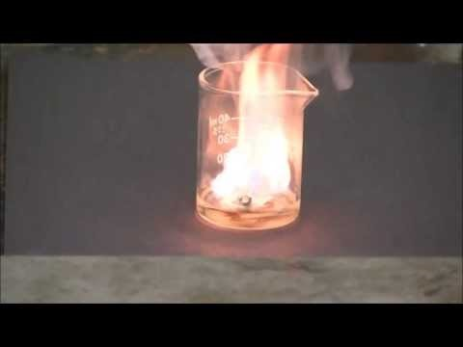

Slide 8
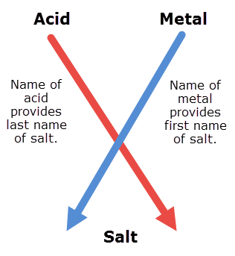
If you combine a metal and an acid into a salt, what do you call the salt?
Salts are named for the acid and metal ions that create them.
The metal provides the first part of the name, and the acid provides the second part.

Slide 9
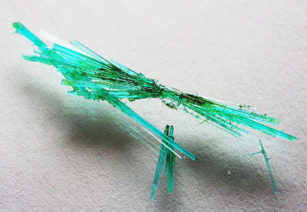
For example, below is the reaction between hydrochloric acid and copper metal:
Hydrochloric acid + Copper → Copper Chloride + Hydrogen
The salt made is copper chloride (shown below), which takes the word copper from the metal and the word chloride from the acid.

Slide 10
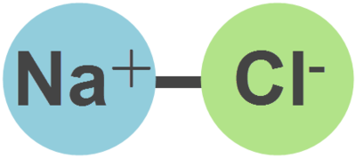
Salts contain two ions, one positive and one negative.
The positive part, the cation, comes from the metal.
The negative part, the anion, comes from the acid.

Slide 11
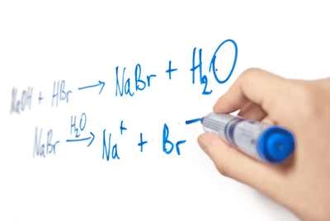
Salt names come from a combination of the cation name and anion name.
Metal cations have the same name as the metal, but anion names are usually different.

Slide 12
Here are some of the most important anions for acid-metal reactions.
When a hydrochloric acid is used, a chloride will form.
When nitric acid is used, a nitrate will form.
When sulfuric acid is used, a sulfate will form.

